Slide 1


3 June 2019
Port Moresby, Papua New Guinea
Sameer Sharma
Senior Advisor, ITU

Slide 2


ITU at a glance
Meet us
What we do
ITU Radiocommunication
Coordinating radio-frequency spectrum and assigning orbital slots for satellites
3
ITU Standardization
Sectors
Establishing global standards
‘Committed to
Connecting the World’
ITU Development
193
+150
+700
Bridging the digital divide
MEMBER STATES
INDUSTRY & INTERNATIONAL
ORGANIZATIONS
ACADEMIA
MEMBERS
MEMBERSHIP

Slide 3
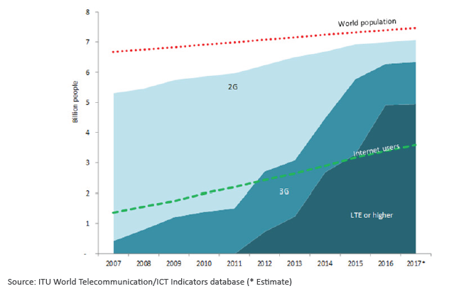
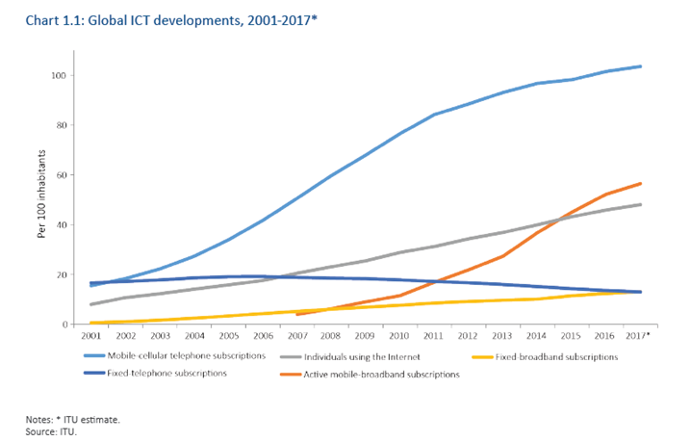
Global ICT Developments Worldwide

Slide 4
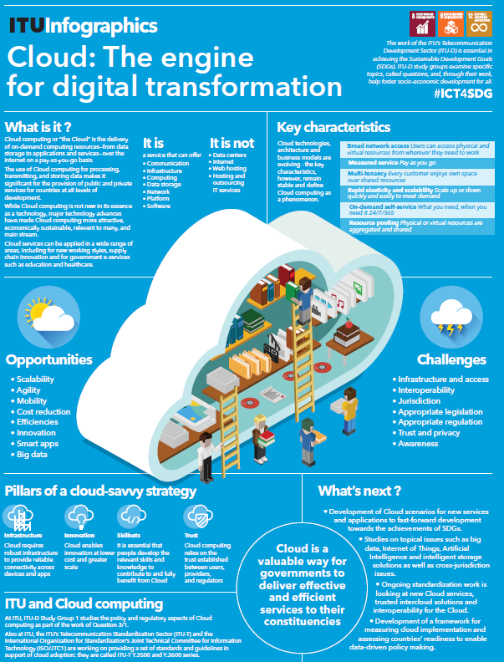
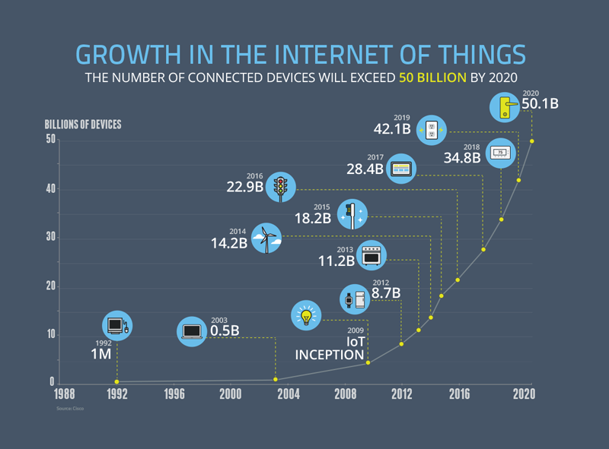

Big data
Internet of Things
Artificial Intelligence
Cloud computing
Source: NCTA.

Slide 5
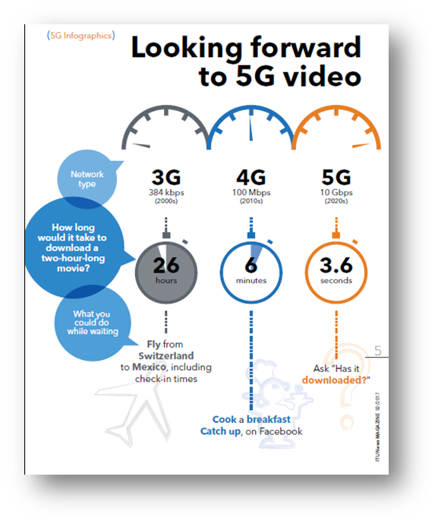
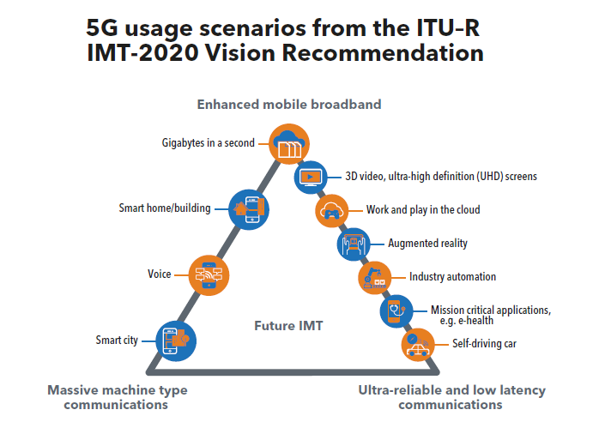
IMT 2020 : 5G and beyond….

Slide 6
CNI Sectors
Information and Communication Technology
Finance
Critical Manufacturing
Food
Health
Energy
Water
Transportation
Security and Defense
Government
In General, we can identify 10 Critical National Infrastructure sectors :

Slide 7
ITU’s Current Cybersecurity Mandate
Enhancing security and building confidence in the use of ICTs is one of priority domains for Objective 2 of the Buenos Aires Action Plan adopted at the 2017 World Telecommunication Development Conference. ​
ITU Plenipotentiary Conference (PP):
Resolution 130 (Rev. Dubai 2018) "Strengthening the role of ITU in building confidence and security in the use of information and communication technologies"
Resolution 174 (Busan 2014) "ITU's role with regard to international public policy issues relating to the risk of illicit use of information and communication technologies"
Resolution 179 (Rev. Dubai 2018) "ITU's role in child online protection"
ITU World Telecommunication Development Conference (WTDC):
Resolution 45​ (Dubai 2014) "Mechanisms for enhancing cooperation on cybersecurity, including countering and combating spam“
Resolution 67 (Buenos Aires 2017) "The role of the ITU Telecommunication Development Sector in child online protection"
Resolution 69 (Buenos Aires 2017) "Facilitating creation of national computer incident response teams, particularly for developing countries, and cooperation between them"
ITU World Telecommunication Standardization Assembly (WTSA):
Resolution 50 (Hammamet 2016) "Cybersecurity“
Resolution 52 (Hammamet 2016) "Countering and combating spam“
Resolution 58 (Dubai 2012) "Encourage the creation of national computer incident response teams, particularly for developing countries"
Related Study Group :
​ITU-D STUDY GROUP 2 (2018 - 2021): Question 3/2: "Securing information and communication networks: Best practices for developing a culture of cybersecurity”
ITU-T STUDY GROUP 17
Notes:
PREVIOUS Related Study Groups you may wish to add as well:
​​​ITU-T Study Group 17: ​​Security​
ITU-D Study Group 2 Question 3: Securing information and communication networks​

Slide 8
Cybersecurity in ITU – A brief timeline
Geneva 2003 – Tunis 2005
WSIS entrusted ITU as sole facilitator for WSIS Action Line C5 - “Building Confidence and Security in the use of ICTs”
In 2007 Global Cybersecurity Agenda (GCA) was launched by the Secretary General of ITU. GCA is a framework for development and international cooperation in cybersecurity
In 2008 ITU Membership endorsed the GCA as the ITU-wide strategy on international cooperation & initiative on COP started.
Building confidence and security in the use of ICTs is widely embedded in ITU Governing Conferences’ resolutions.

Slide 9
ITU’s Role in Tackling Cyber Threats
To build confidence and security in the use of telecommunications/ICTs, develop and implement standards in cybersecurity on International Level
Assist Member States to strengthen cybersecurity capacity to effectively share information, find solutions, and respond to cyber threats, and to develop and implement national strategies and capabilities, including capacity building, encouraging national, regional and international cooperation towards enhanced engagement among Member States and relevant players
Develop products and services for building confidence and security in the use of telecommunications/ICTs, such as reports and publications, and for contributing to the implementation of national and global initiatives

Slide 10
Cybersecurity Services Catalogue
National Cybersecurity Strategy Development
National Cybersecurity Assessment
National Cybersecurity Assistance
Global, Regional and National events
Global Cybersecurity Index
Engagement and awareness
Computer Incident Response Team (CIRT) Program
CIRT Readiness Assessment
CIRT Design
Information sharing
High-Level Cybersecurity Simulations
Partnership
Development
Critical Infrastructure Protection Assistance
Technical Assistance
CIRT Establishment
CIRT Enhancement
Human Capacity Development
Curricula and Training Programs
Bespoke Training
Institutional Capacity Development
Regional Cyberdrills
National Cyberdrills
Good Practices
Study Groups
Information Exchange Tools and Techniques
Publications
ITU News Platform
Service areas
CAPACITY DEVELOPMENT
Services

Slide 11

National Cybersecurity Strategy (NCS)
GUIDE TO DEVELOPING A NATIONAL CYBERSECURITY STRATEGY
This Guide has primarily been structured as a resource to help government stakeholders in preparing, drafting and managing their National Cybersecurity Strategy.
(This guide will be launched in September 2018)

Slide 12
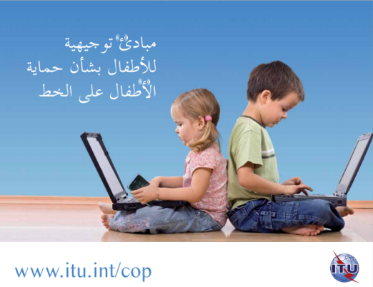
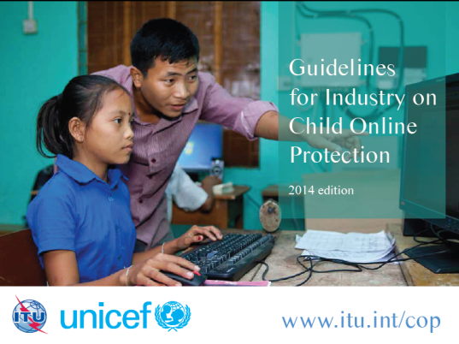

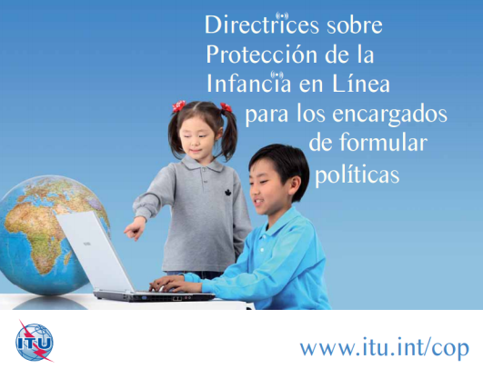
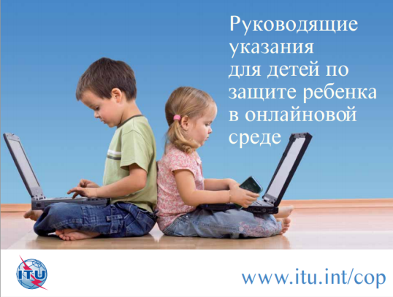

Protecting Children in Cyberspace:
ITU- UNICEF- INDUSTRY 4 Set of COP Guidelines
Developed in cooperation with COP partners, is the first set of guidelines addressing different stakeholders. Available in the six UN languages
Notes:
Copies of them are outside…

Slide 13


Global Cybersecurity Index
Goals
Help countries identify areas for improvement
Motivate action to improve relative GCI rankings
Raise the level of cybersecurity worldwide
Help to identify and promote best practices
Foster a global culture of cybersecurity

Slide 14


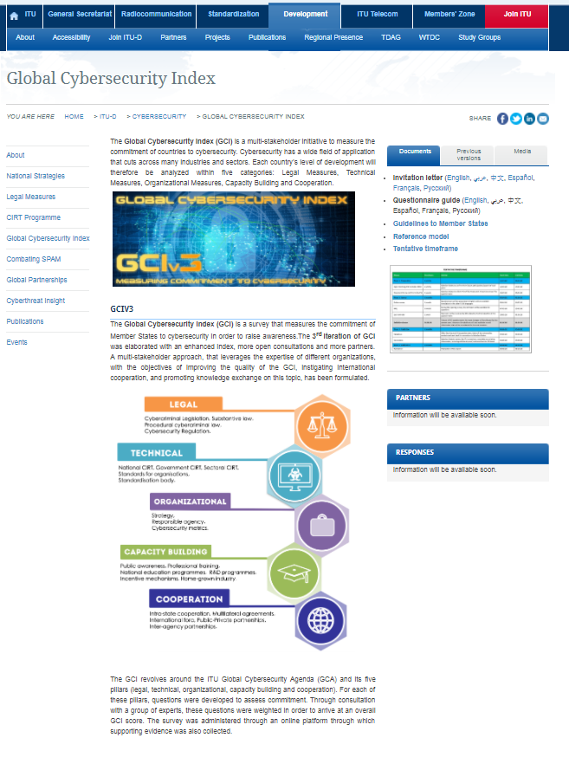
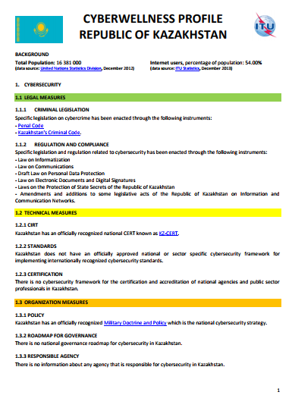

Global Cybersecurity Index - Background
GCIv1 – the 1st iteration of the GCI has started in 2013-2014 period -105 countries responded
GCIv2 – the 2nd iteration covered 2016-2017 period – 134 countries responded
GCIv3 – 3rd iteration – 155 countries responded to the process
All iterations include primary research in order to provide global coverage of the 194 Member States

Slide 15
Key findings: Global top 10
Rank | Member States | GCI Score | Legal | Technical | Organizational | Capacity building | Cooperation
1 | United Kingdom | 0.931 | 0.200 | 0.191 | 0.200 | 0.189 | 0.151
2 | United States of America | 0.926 | 0.200 | 0.184 | 0.200 | 0.191 | 0.151
3 | France | 0.918 | 0.200 | 0.193 | 0.200 | 0.186 | 0.139
4 | Lithuania | 0.908 | 0.200 | 0.168 | 0.200 | 0.185 | 0.155
5 | Estonia | 0.905 | 0.200 | 0.195 | 0.186 | 0.170 | 0.153
6 | Singapore | 0.898 | 0.200 | 0.186 | 0.192 | 0.195 | 0.125
7 | Spain | 0.896 | 0.200 | 0.180 | 0.200 | 0.168 | 0.148
8 | Malaysia | 0.893 | 0.179 | 0.196 | 0.200 | 0.198 | 0.120
9 | Canada | 0.892 | 0.195 | 0.189 | 0.200 | 0.172 | 0.137
9 | Norway | 0.892 | 0.191 | 0.196 | 0.177 | 0.185 | 0.143
10 | Australia | 0.890 | 0.200 | 0.174 | 0.200 | 0.176 | 0.139

Slide 16

CIRT Framework
IMPROVEMENT
ESTABLISHMENT
DESIGN
ASSESSMENT
Focused on Incident Responses capabilities with National responsibilities
Aligned with the FIRST Service Framework

Slide 17
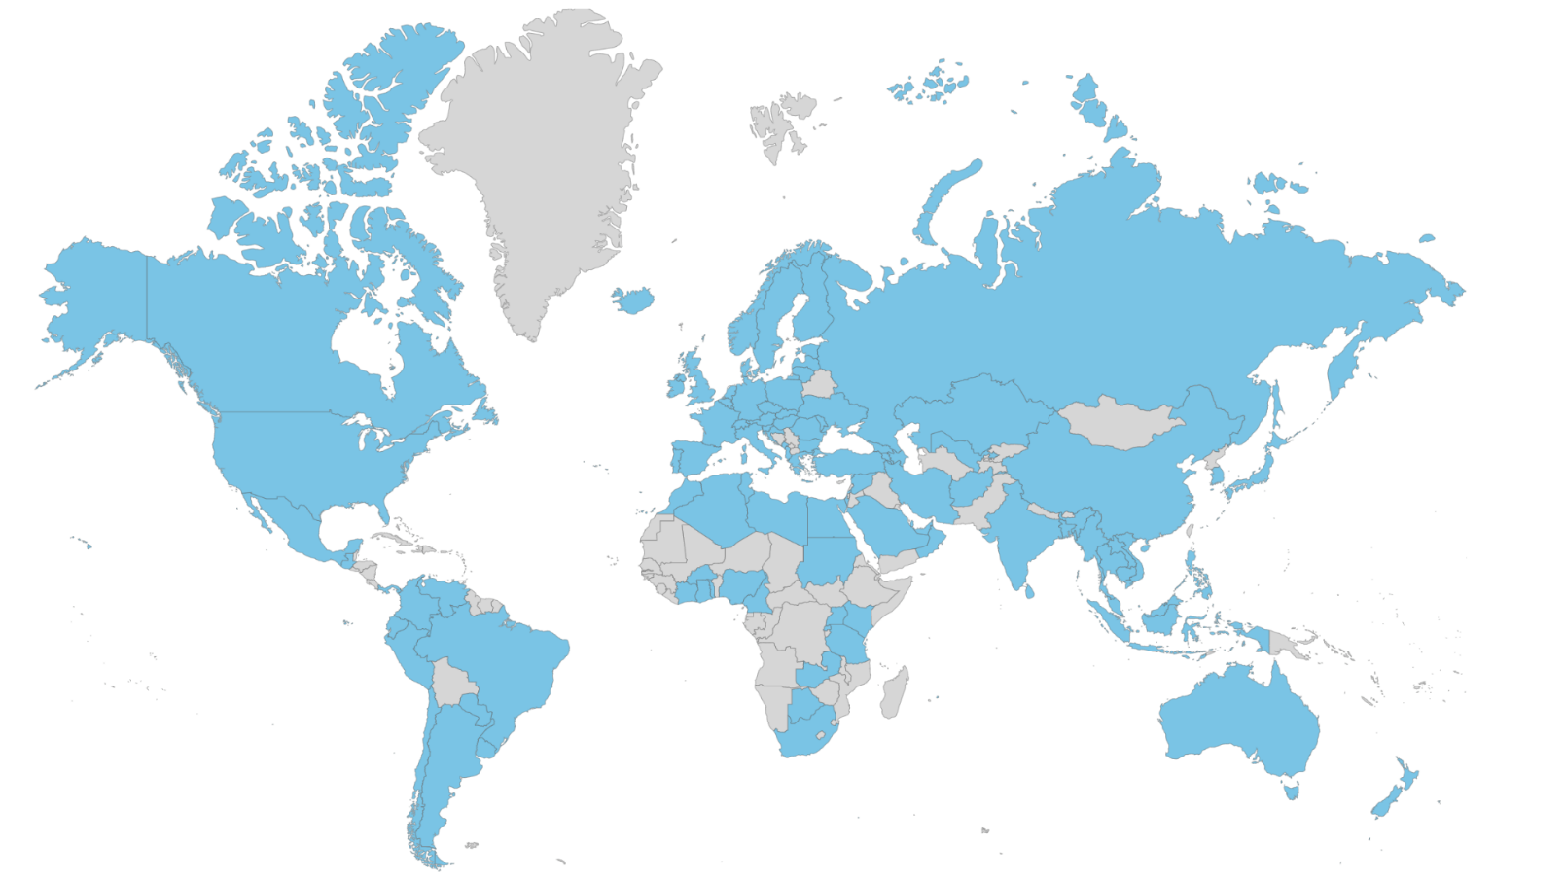
ITU CIRT Projects
CIRT Framework
73 National CIRT ASSESSMENT
Africa : Angola, Botswana, Burkina Faso, Burundi, Cameroon, Central African Republic, Chad, Congo (Dem Rep), Congo (Republic), Côte d'Ivoire, Gabonese Republic, Gambia, Ghana, Kenya, Lesotho, Liberia, Madagascar, Malawi, Mali, Mozambique, Niger , Nigeria, Rwanda, Senegal, Sierra Leone, eSwatini, Tanzania, Togolese Republic, Uganda , Zambia, Zimbabwe
Americas: Anguilla, Antigua, Barbados, Bolivia, Dominica , Dominican Republic , Ecuador, Grenada, Honduras, Jamaica , St Kitts & Nevis, St Lucia, St Vincent & The Grenadines, Suriname,​ Trinidad and Tobago
Arab region: Comoros, Djibouti, Jordan, Lebanon, Mauritania, Palestine, Sudan
Asia & Pacific: Afghanistan, Bangladesh , Bhutan, Cambodia, Fiji, Laos, Maldives , Myanmar, Nepal , Samoa, Tonga, Vanuatu, Vietnam, Papua New Guinea
Europe & CIS: Albania , Armenia, Cyprus, Macedonia, Monaco, Montenegro, Serbia
14 National CIRT designed and established
Barbados
Burkina Faso
Cote d’Ivoire
Cyprus (Governmental CIRT & National CIRT​)
Ghana
Jamaica
Kenya (+ Enhancement in progress)
Montenegro
Tanzania
Trinidad and Tobago
Uganda
Zambia
In the Pipeline we've 6 CIRT Projects:
103 National CIRT
Zimbabwe
Burundi
Honduras
State of Palestine
Mauritania
Guyana

Slide 18
CIRT Services
Reactive Services | Proactive Services | Security Quality Management Services
Alerts and warnings | Announcements | Risk analysis
Incident handling | Technology watch | Business continuity & disaster recovery planning
Vulnerability handling | Security audit / assessments | Security consulting
Artifact handling | Configuration & maintenance of security tools, applications & infrastructure | Security awareness building
 | Development of security tools | Education / training
 | Intrusion detection services | Product evaluation or certification
 | Security related information dissemination

Slide 19
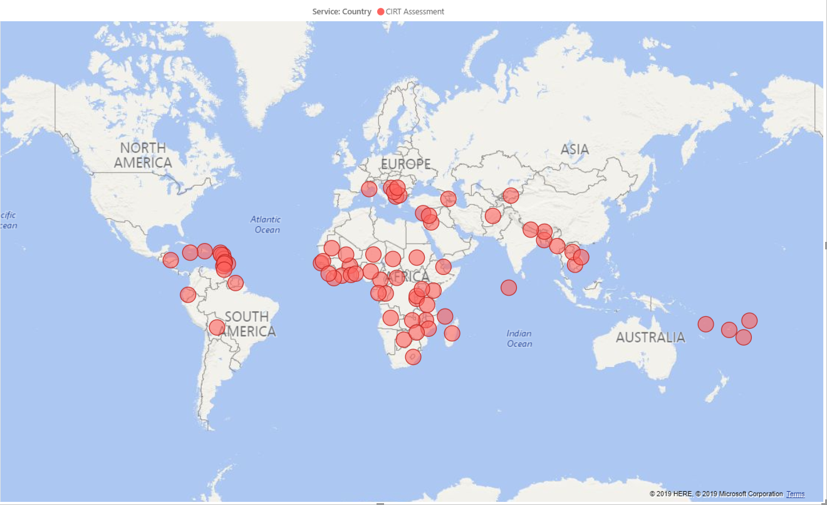
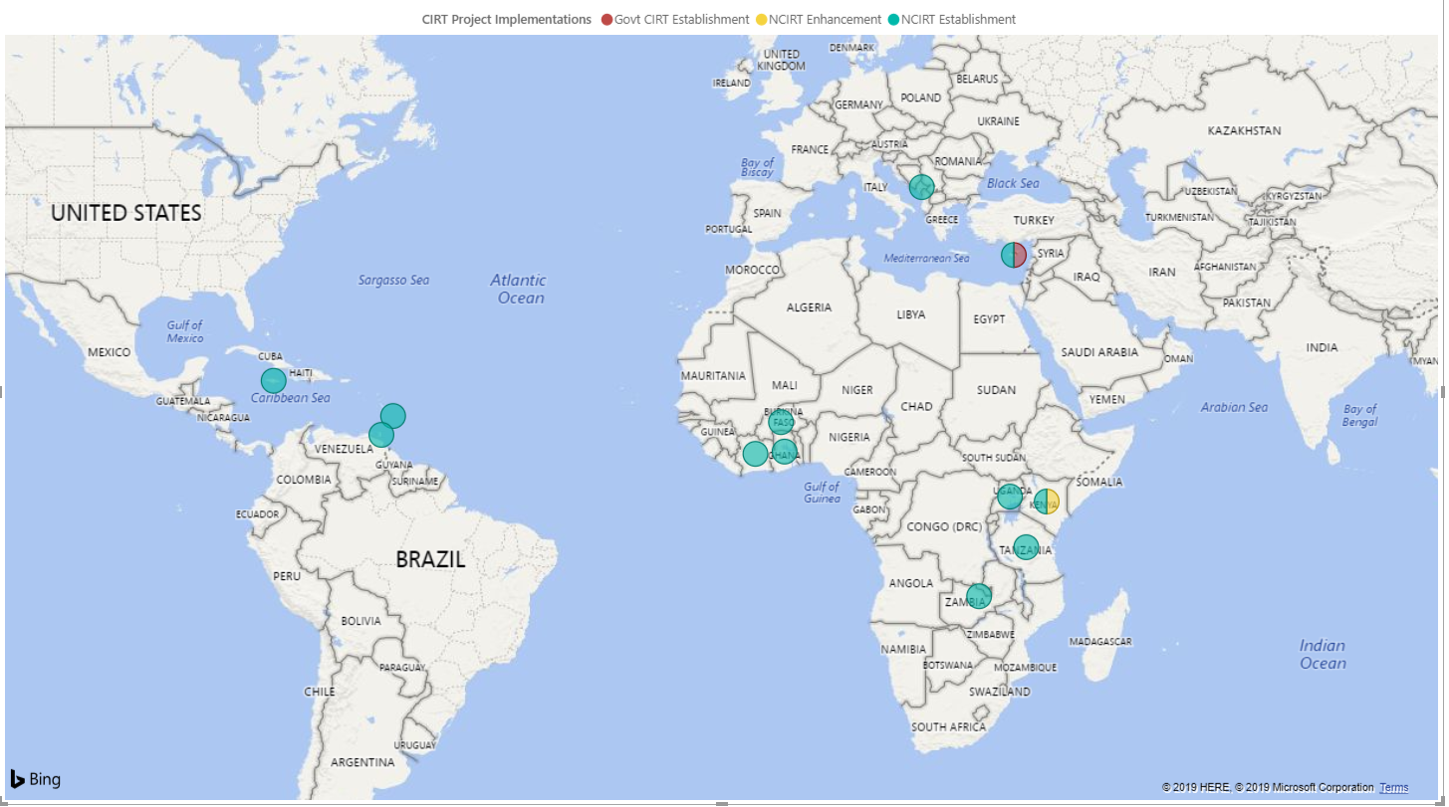

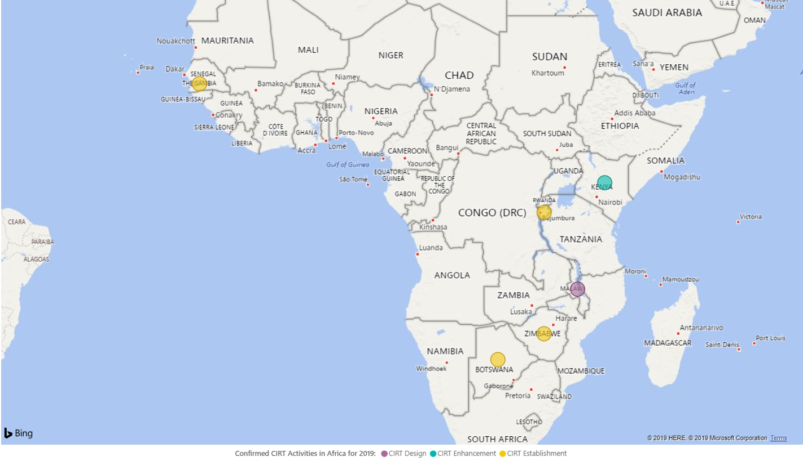
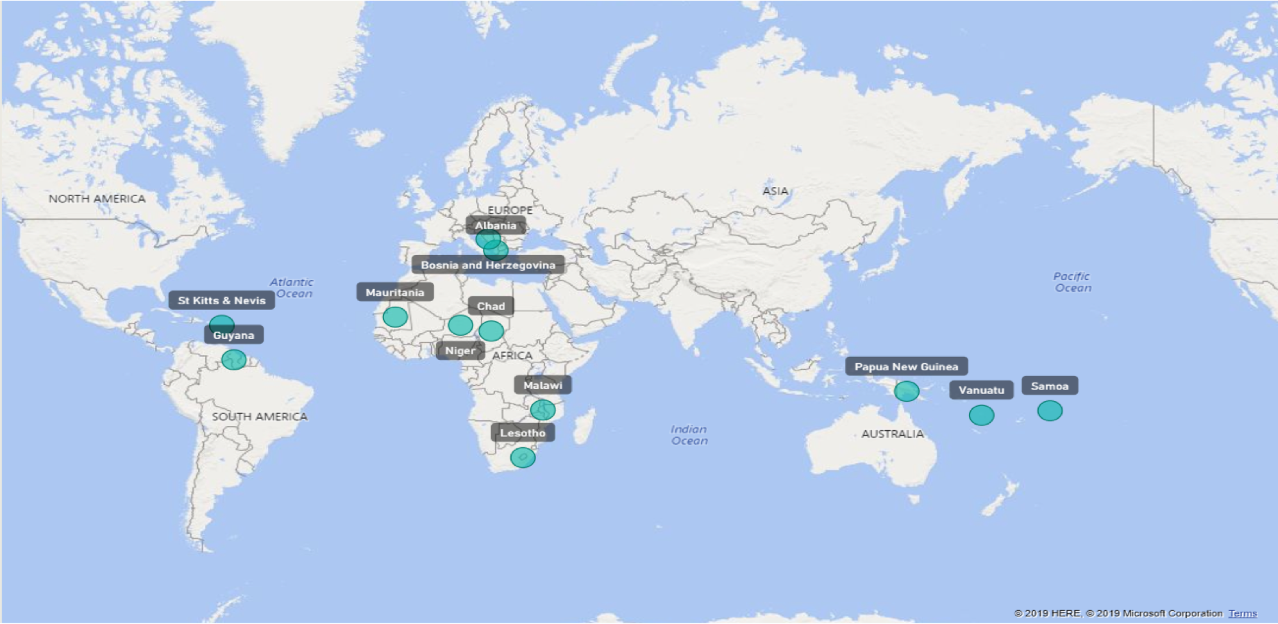
75 CIRT READINESS ASSESSMENTS
13 CIRT ESTABLISHMENT + 1 ENHANCEMENT
Establishment National CIRT
Establishment Govt. CIRT
Enhancement National CIRT
Establishment National CIRT
Design National CIRT
Enhancement National CIRT
CIRT ESTBLISHMENT IN 2019
CIRT ESTABLISHMENT– INTERESTS
Notes:
-

Slide 20
Regional CyberDrills
Enhancing Cybersecurity capacity and capabilities through regional collaborations and cooperation;
Enhancing the awareness and the capability of countries to participate and to contribute to the development and deployment of a strategy of defeating a cyber threat;
Strengthening International Cooperation between Member States to ensure continued collective efforts against cyber threats;
Enhancing Member States’ and incident response capabilities and communication;
Assisting Member States to develop and implement operational procedures to respond better to various cyber incidents, identify improvements for future planning CIRT processes and operational procedures.

Slide 21
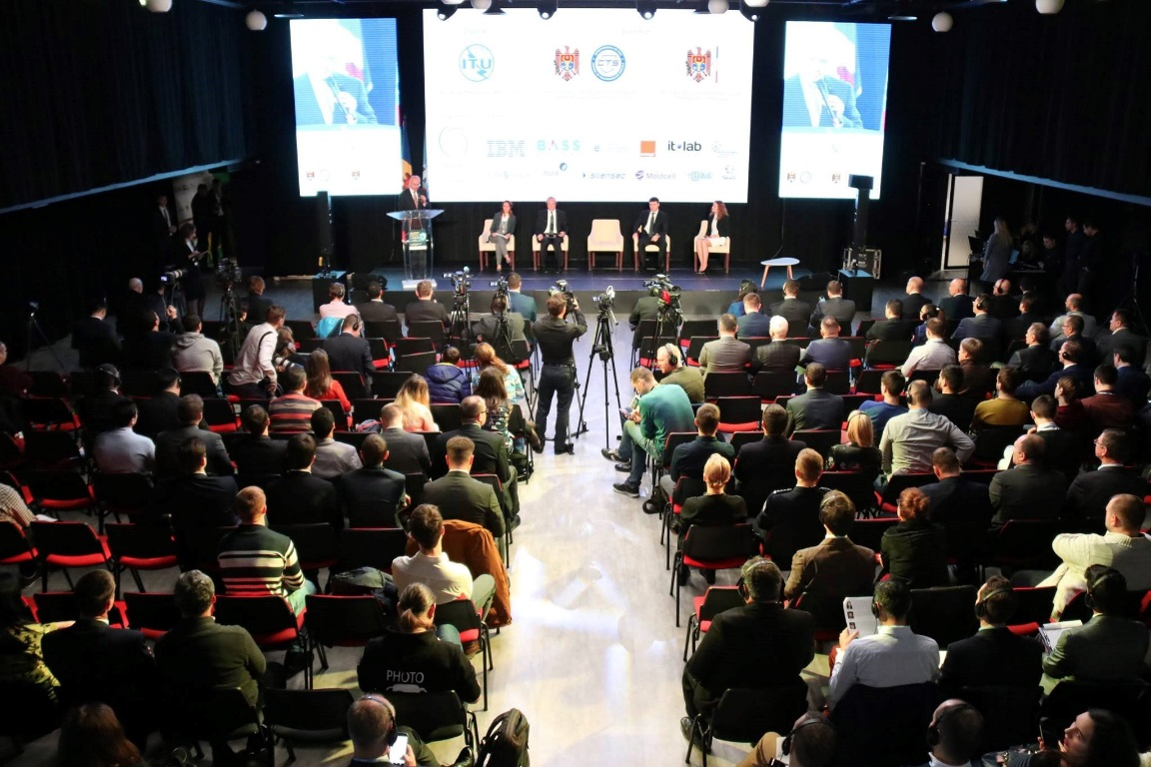
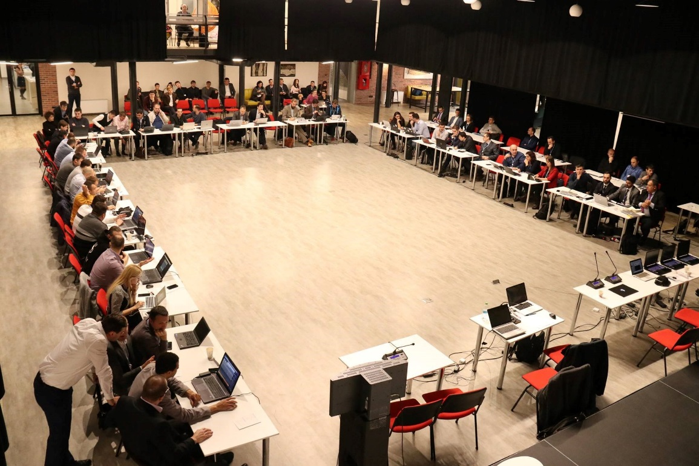
Regional CyberDrills
The 1st and 2nd days are dedicated for the organization of capacity building sessions, or other themes, such as COP-related workshop etc.
The 3rd day is the conference day that includes presentations and panel discussions on current issues, latest assessment and current trends in cybersecurity threats.
The 4th and 5th days are structured around scenarios consist of several incidents involving the most common types of attacks.

Slide 22
Cybersecurity in Asia-Pacific region
Cyber Drill for Asia-Pacific and CIS Regions​, 23-27 September 2019, Kuala Lumpur, Malaysia
National Cybersecurity Strategies : Bhutan, Kiribati ( 2018)
ITU- ICT Faculty fact to face training on Cybersecurity, 12-16 May 2018, Iran
CERT Assessment and Training for Samoa and Tonga ( 2018)
Cybercrime Legislation and ITU –UNODC- INTERPOL Workshop (2017)
National Cybersecurity Strategy & Cybersecurity Awareness : Nepal (2016-2015)
Readiness Assessment to Establish a National CIRT for Fiji (2014-2015)
Workshop on Cybersecuirty and Cybercrime Legislation & Cybersecurity Incident Simulation Bangkok, 2015
INTERPOL-ITU Cybercrime Investigation Seminar,19-21 Feb 2014, Malaysia
​First Pacific Islands Capacity Building Workshop on Child Online Protection and Commonwealth National Cybersecurity Framework Regional Workshop, 22-24 September 2014, Vanuatu
Establishment of Pac CIRT, Fiji
Readiness assessment National Cybersecurity Strategy, Bangladesh ( 2013)
ITU Cyber Security Forum & Cyber Drill, 9-11 Dec 2013, Vientiane, Lao P.D.R
Enhancement of cybersecurity capabilities (CIRT) Bhutan (2013)
CIRT Capacity Building for Afghanistan (2014 and 2015)

Slide 23
Cybersecurity in Pacific Island Countries 2018-19
PROJECT OBJECTIVE
The objectives of this proposed project are:
To establish and strengthen of national CIRTS and enhancing coordination, collaboration and information exchange between national CIRTs and with other relevant players;
To strengthen national cybersecurity policy frameworks that will include assessment and design of national CIRTs from civilian usage perspective;
To build human and institutional capacity for efficient and effective use of capabilities of CIRTs .
EXPECTED RESULTS
Stronger coordination, collaboration and information sharing between CIRTS and other relevant players;
Readiness assessments for national CIRT establishment for selected Pacific Island countries namely Tonga, Samoa, Papua New Guinea and Vanuatu;
Design and implementation plan for each national CIRT;
Stocktaking of activities being undertaken in the selected countries by national, regional, and international organisations, and in the region in general; and
Awareness and hands-on training workshops aimed at building and strengthening human capacity in cybersecurity related matters in general and CIRTs in particular.

Slide 24
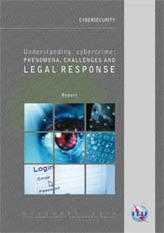
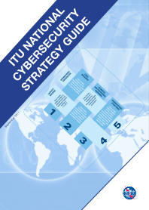
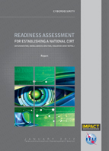
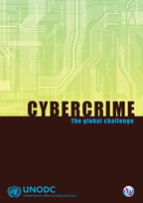
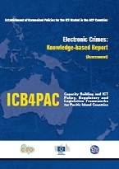
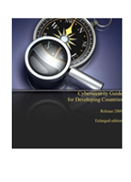


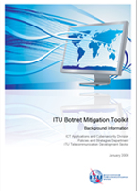
ITU Resources / Publications on Cybersecurity

Slide 25
Conclusions
While it will never be possible to completely remove all risks, drawing together an effective policies and practices, infrastructure & technology, awareness and communication can do a great deal to help.
Cybersecurity and Critical National Information Infrastructure requiring political will and commitment to have clear National Cybersecurity Strategy , Cyber Crime Legislation , Child Online Protection, establishment / strengthening the CIRTs/ regular national / regional Cyber Drills
Human and institutional capacity building critical to understand and take reactive / proactive response to address cyberthreats
International cooperation, based on a multi-stakeholder approach, is the key and by working together with ITU and its partners, together we can realize Safe and Secure Cyber-space!

Slide 26
ITU : I Thank U

